Slide 1

BOX JUMPER
BY RYAN BOYD AND JEROMY BAMO
CS380 Project

Slide 2
HOW TO PLAY BOX JUMPER
OBJECTIVE:
Get the highest score by jumping over the boxes:
How the game works:
Jump over the boxes to stay alive.
If you run into a box the game is over.
The score system is biased of time played in seconds.

Slide 3
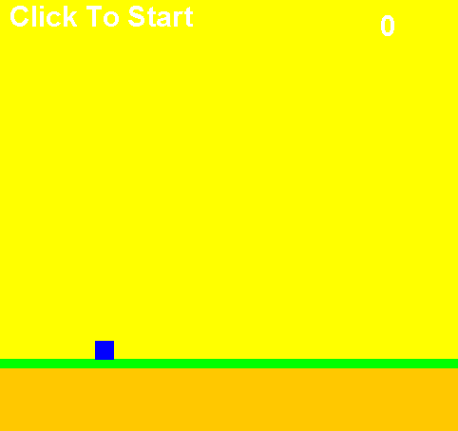
Starting the game.
Launch the game and make sure the brick.png is on the desktop
Next you will see in the top right-hand corner click here to start.
Once your score is higher than 1 the click here to start will go away
Next press the space bar to jump

Slide 4
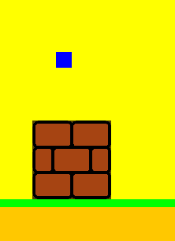
GETTING THE SCORE!
Avoid the brick by pressing the space bar to jump over them.
You can also use your mouse by clicking to jump over them as well

Slide 5
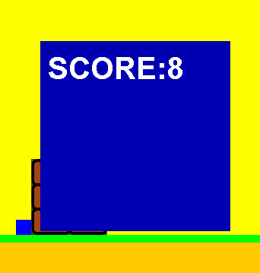
GAME OVER
If you run into a brick the game is over.
Your score will be displayed on the screen

Slide 6
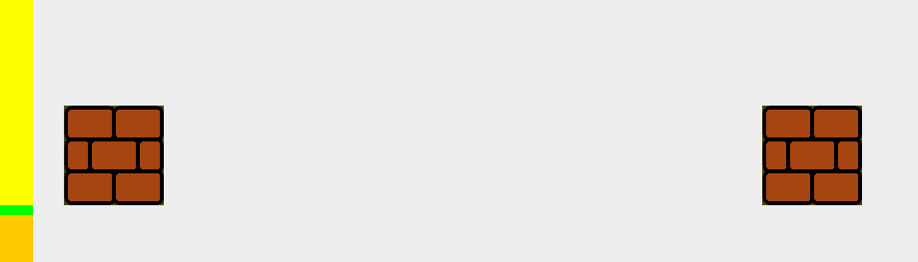
USEFUL INFORMATION
The space between every brick is randomized so make sure you pay attention. If you jump to early or to late you will land on the brick.

Slide 7
LIVE DEMONSTRATION
Now we will give you a live demonstration on how the program works.

